Slide 1
Docker Networks

Slide 2
Basic setup
docker run nginx
port 80
NGINX
Bridge Network (default)

Slide 3
Basic setup
docker run –p 80:80 nginx
port 80
port 80
NGINX
Bridge Network (default)

Slide 4
Multiple Containers
docker run –p 80:80 nginx
docker run redis
port 80
port 80
NGINX
port 6379
Redis
Bridge Network (default)

Slide 5
Custom Networks
Allow you to refer to other containers by the name you give them with the --name value in docker run
The default bridge network only lets you refer to other docker containers by their IP address

Slide 6
Custom Network
docker run --network customNet -p 80:80 myGoServer
docker run --network customNet --name rServe redis
port 80
API calls to “rServe:6379”
port 80
myGoServer
port 6379
Redis:
rServe
customNet
(docker network create customNet)

Slide 7
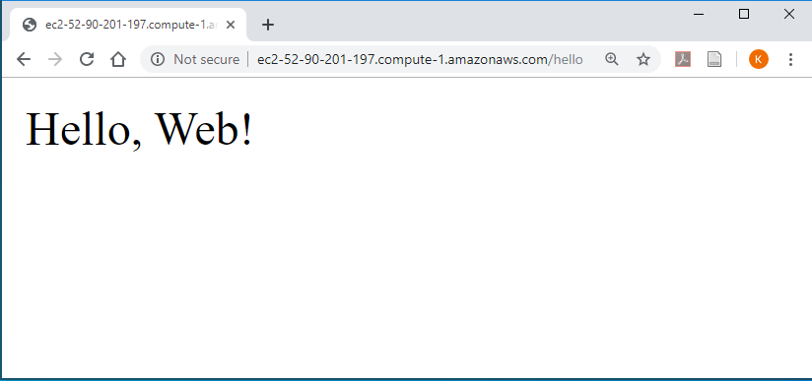
Communication w/ browser (ignoring HMAC signing)
port 443
Log in (send pwd)
port 443
Browser
myGoServer
Authenticated: B*&A
port 6379
Invent Auth Token: B*&A
AuthToken: B*&A
Redis:
rServe
B*&A: User 1
Email DB
customNet

Slide 8
Communication w/ browser (ignoring HMAC signing)
port 443
Get Emails (AuthToken: B*&A)
port 443
Browser
myGoServer
Email Contents
port 6379
Check for: B*&A
Get email for User 1
AuthToken: B*&A
Redis:
rServe
B*&A: User 1
Email DB
customNet

